Slide 1
ENSF 612
PROJECT PRESENTATION II
Presented By:
GROUP 1:
Taruneesh Sachdeva
Neha Singh
Sanyam

Slide 2
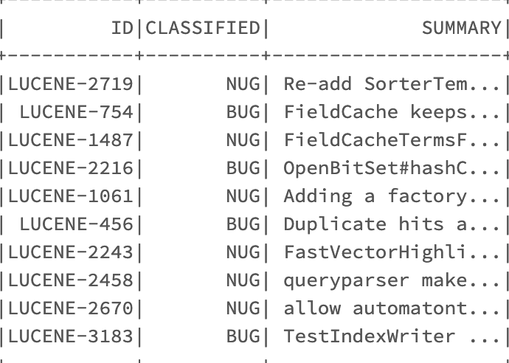
Completion of Data Collection
We took 3 datasets from ‘https://www.st.cs.uni-saarland.de/softevo//bugclassify/ ’, collated them and further added 1000 new issue reports which were manually classified. We combined all the dataframes into one single dataframe called df_issue_report which contains the Summary and label column.

Slide 3
2. Quality of Data Labeling
Based on the Summary column, we manually classified the additional 1000 issue reports.
Following are some of the issue IDs on which we had disagreements:

Slide 4
Some more examples:
Taruneesh and Sanyam agreed on 40 labels out of 50, therefore the percentage agreement was 80%.
Similarly, Sanyam and Neha agreed on 42 labels out of 50, therefore the percentage agreement was 84%.
Neha and Taruneesh had an agreement on 44 out of 50 labels. Therefore, the percentage agreement was 88%.

Slide 5
3. Data Preprocessing
We implemented a function preProcessData() for :
The removal of punctuation,
The removal of spaces
Conversion to lower case and any further noise.
Also for the remaining preprocessing, we made separate three functions for
Tokenization of Data
Removal of stopwords
Stemming

Slide 6
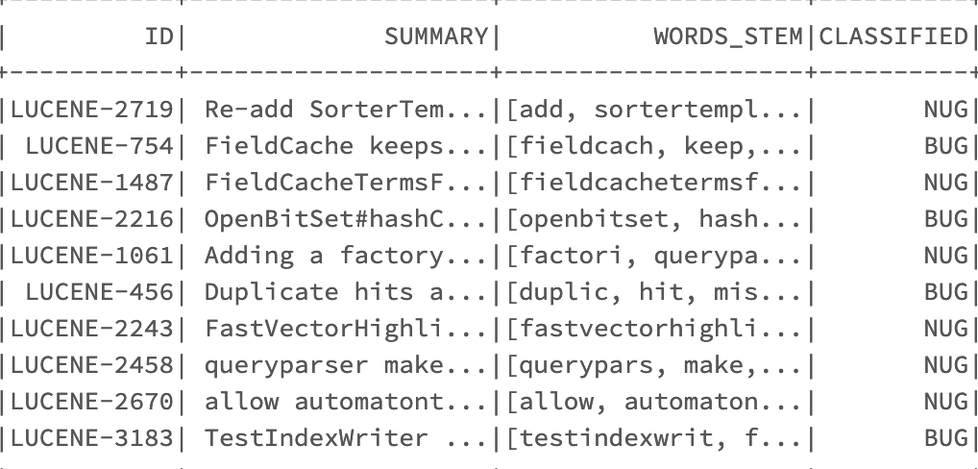
Clean Dataframe

Slide 7
4. Features generated to train the machine learning models
After preprocessing, WORDS_STEM has the processed data . Then,
Training and testing datasets are generated using randomSplit()
Document Term Matrix (DTM) is generated for the training dataset using CountVectorizer()
Based on the vocabulary of the training DTM, testing DTM is generated
BUG/NUG classes are labeled as 1/0 in the target column

Slide 8
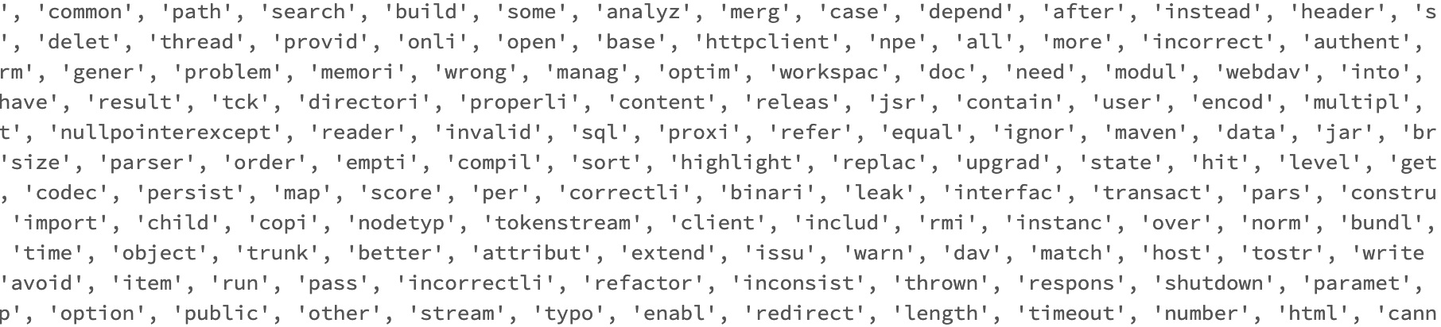
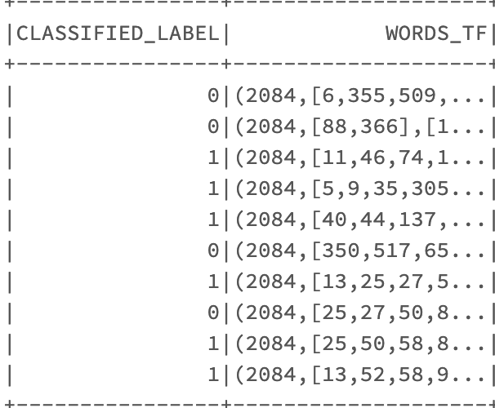
An example of features list
An output of our df_train vectorized dataframe

Slide 9
5. A theoretical overview of how a machine learning model can use the features.
The next step is applying the Machine Learning models.
Words_TF column is the feature column, which has features in the sparse matrix form.
The Target column is the ‘CLASSIFIED’ column where 0 represents NUG and 1 represents a BUG.
Thus, the model(s) will be trained based on the above two columns and accuracy, average precision and weighted F1 score will be calculated.

